Slide 1
In the name of ALLAH
…….. + er = ?

Slide 2
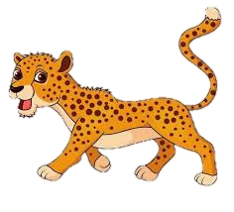

The cheetah is faster than turtle.

Slide 3

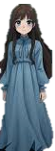
Zohreh is taller than Zahra.

Slide 4
1.
…….+er=……er
Example : faster _ older

Slide 5


Today is hotter than yesterday.

Slide 6

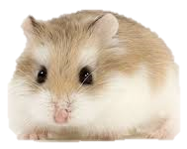
The bear is fatter than hamster.

Slide 7
2.
Cvc ( fat _ sad _ big ) + er = cvccer
Example : fatter _ sadder _ bigger

Slide 8


The is cuter than Maryam.

Slide 9
3.
……e + er = …...er
Example : cuter _ braver _ nicer

Slide 10
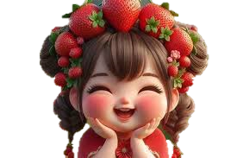

Helma is happier than sara.

Slide 11
4.
..…..y + er = …….ier
Example : funnier _ prettier _ uglier
( Y = I )

